Slide 1

Descriptive Statistics 2
Investigation & Report

Slide 2
Topics of this lecture
Measures of central tendency
Measures of dispersion

Slide 3
Measures of Central Tendency
Some idea of the typical or average case in the distribution
A single value that attempts to describe a set of data by identifying the central position within that set of data
Powerful: Reduces huge arrays of data to a single number
Measures of central tendency → We often compare scores of subunits with the typical or average social behavior

Slide 4
Mode: Most Frequent or Common Score
Scores: 92, 88, 74, 92, 53, 74, 87, 92, 74, 75, 55, 92, 88
Arrange: 53, 55, 74, 74, 74, 75, 87, 88, 88, 92, 92, 92, 92
More than one mode is possible
92
Religion | Frequency
Protestant | 128
Catholic | 57
Jew | 10
None | 32
Other | 15
N | 242
We can also mode when variables are measured at the nominal level

Slide 5
Median: Middle Case
Always represents the exact center of a distribution
Half of the numbers are smaller & the other half are greater than the median
Scores: 92, 88, 74, 92, 53, 74, 87, 92, 74, 75, 55, 92, 88
Arrange: 53, 55, 74, 74, 74, 75, 87, 88, 88, 92, 92, 92, 92
Even number of cases → Average of the two middle cases
Arrange: 53, 55, 74, 74, 74, 75, 87, 88, 88, 92, 92, 92, 92, 97
(87+88)/2 = 87.5

Slide 6
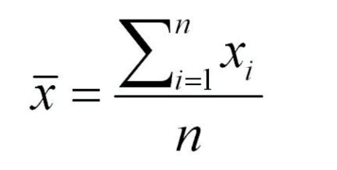

Mean: Typical Score of the Cases
Mean or arithmetic average is by far is the most commonly used measure of central tendency
Compute: Add all scores an then divide by the number of score (N)

Slide 7
Special Characteristic of the Mean
Every score in the distribution affects it
Advantage: Utilizes all available information
Disadvantage: When a distribution has a few very high or very low scores, the mean may become a very misleading measure of centrality
Five scores: 15, 20, 25, 30, 35
Mean: 125/5= 25; Median: 25
Five scores: 15, 20, 25, 30, 3500
Mean: 3590/5=718; Median: 25
The mean & the median will have the same value when & only when a distribution is symmetric
When a distribution has extremely high scores (positive skew) the mean will have a greater numerical value

Slide 8
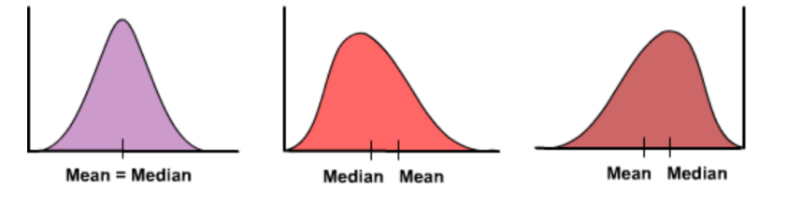
Symmetric & Skewed Distributions
A classic example of the right-skewed distribution is income (salary), where higher-earners provide a false representation of the typical income if expressed as a mean and not a median
Symmetric Distribution
Right-Skewed Distribution
Left-Skewed Distribution

Slide 9
Measures of Dispersion
Measures of central tendency → Locate the typical or central scores
Measures of dispersion → Provide information about the amount of variety, diversity or heterogeneity
Common examples of measures of statistical dispersion are the variance, standard deviation, ranges
Good measure of dispersion should
Use all the scores in the distribution → All the information available
Describe the average or typical deviation of the scores → How far the scores are from the center of the distribution
Increase in value as the distribution of scores becomes more diverse

Slide 10
Dispersion
Suppose that a manager wants to evaluate the performance of two delivery truck drivers
Average time per delivery: The average time it takes to complete a delivery over a specific period
The daily averages (means) of the two drivers are very close to each other
Measures of dispersion however reveal substantial differences in the distributions of delivery times
Courier B → More scores in the high and low ranges.
More diverse
More variety
Courier A → Scores are more grouped around the mean
More consistent
Less dispersion

Slide 11
Deviation
Distances between each score and the mean
If scores are clustered around the mean → Deviations are small
Five scores: 10, 20, 30, 40, 50
Mean = 150/5=30
But, sum of the deviations is always zero → Square each of the deviations
 | Scores | Deviations | Deviations Squared
 | 10 | (10-30)= -20 | (-20)²= 400
 | 20 | (20-30)= -10 | (-10)²= 100
 | 30 | (30-30)= 0 | (0)²= 0
 | 40 | (40-30)= 10 | (10)²= 100
 | 50 | (50-30)= 20 | (20)²= 400
Sum | 150 | 0 | 1,000

Slide 12


Almost there…
The sum of squared deviations will increase with sample size
We need to standardize for sample of different sizes
Divide the sum of squared deviations by N (sample size)
Variance →
Standard deviation →
Standard deviation → Higher for the more diverse distributions and lower for less diverse distribution
When standard deviation is 0 → Every single case in the sample had exactly the same score
Standard deviation → Average or standard distance of a set of values from the mean

